Slide 1

E-Cart Shopping
Group Members:-
- Anand Dhokchaule
- Suyash Mhatre
- Praveen Pal
- Nitin Jadhav
- Imran Tamboli Under the guidance of
- Omkar Thakur Praisy mam

Slide 2

What is E-Commerce:-
E-Commerce refers to the buying and selling of goods and services over the internet or other electronic networks.

Slide 3
Introduction :-
E-cart shopping refers to the practice of purchasing products online through an electronic shopping cart or a virtual shopping cart.
It allows customers to select products from an online store ,add them to their shopping cart ,and then proceed to checkout to complete the purchase.
Online shopping platforms also offer various payment options ,including credit/debit cards ,net banking ,e-wallets ,and cash on delivery ,making the process of purchasing goods hassle-free.

Slide 4

NEED FOR THE SYSTEM :-
This software helps to maintain the track records of sales, purchases, receipts, Payment, Inventory, Maintenances and other related issues. It helps in replacing the manual system of record keeping with the modern computerized system.

Slide 5
Modules Of The System :-
1. Login Module :-
In this module the admin and customer can register and login to the system by entering
login id and password. The system opens home page after successful login.
2. Account Module :-
There are two types of registered accounts in the system :
Admin : who is responsible for adding new product categories and blocking
/unblocking members.
Customer : A Member, who can buy products.
Guest : Guests can search for and view products ,and add them in the shopping cart.
To place an order they have to become a registered member.

Slide 6
3. Product Module :-
This module will encapsulate the entity that the users system will be buying and selling.
4. Cart Module :-
Users will add product items that they intend to buy to the shopping cart.
5. Order Module :-
This will encapsulate a buying order to buy everything in the shopping cart.
6. Payment Module :-
This module will encapsulate the payment for an order. Members can pay through credit
card or electronic bank transfer.
7. Shipment Module :-
Will keep a track of the status of shipments, such as pending, shipped, delivered, etc.

Slide 7
Hardware Requirements :-
Processor: X86 Compatible processor with 1.7GHz speed.
Hard disk: 64 GB and Above.
RAM: 4GB
Monitor: VGA/SVGA/Colour Monitor.
Other Hardware: Keyboard, Mouse, etc.
Software Requirements :-
Front-End: HTML ,CSS ,AngularJs ,MaterialUi.
Back-End: Java.
Framework: SpringBoot (STS Suite 4.17.2).
Database: MySQL 8.32
Server: Node.Js (16.0.30)

Slide 8
Future Scope :-
The future of e-commerce and online shopping applications is very promising, as these platforms continue to evolve and innovate to meet the changing needs of consumers.
Overall, the future of e-commerce and online shopping applications is bright, as platforms continue to innovate and develop new ways to make the shopping experience more personalized, convenient, and engaging for customers.

Slide 9
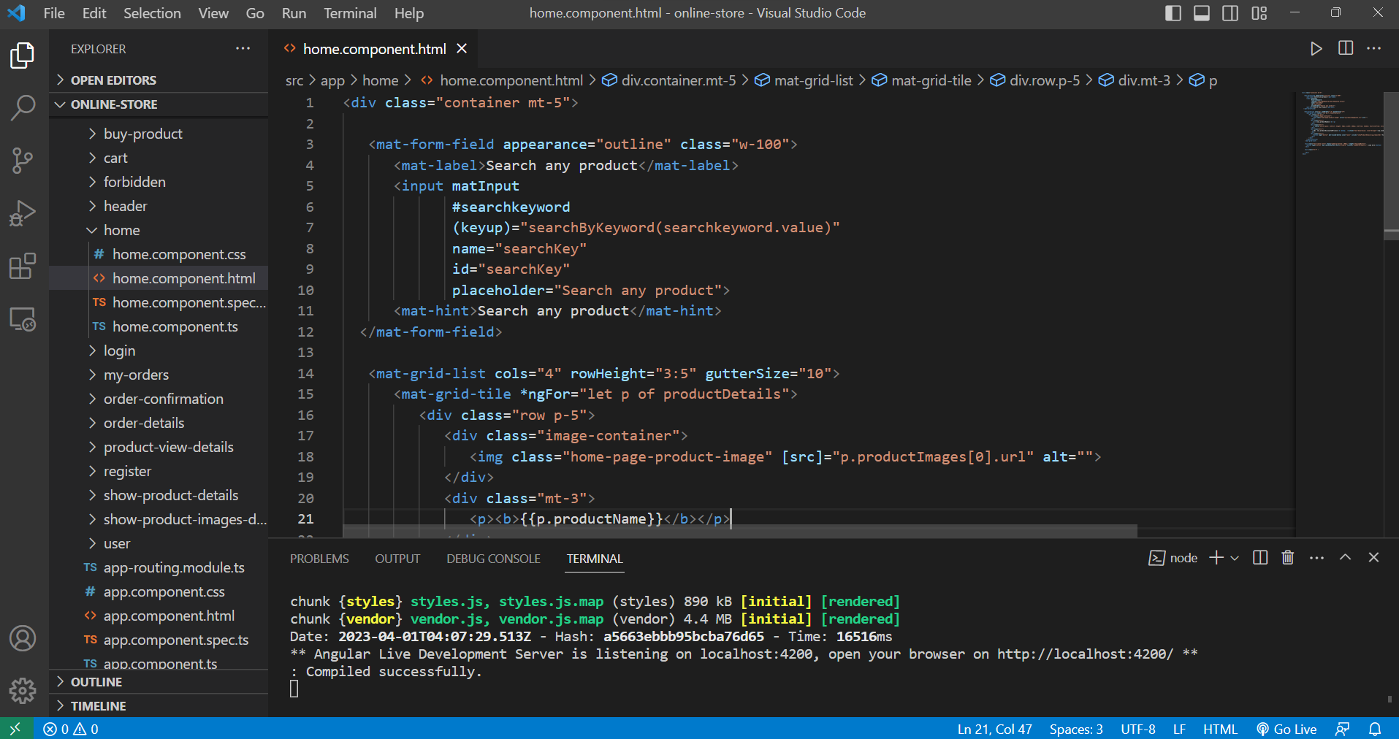
Front-End Snapshot:-

Slide 10
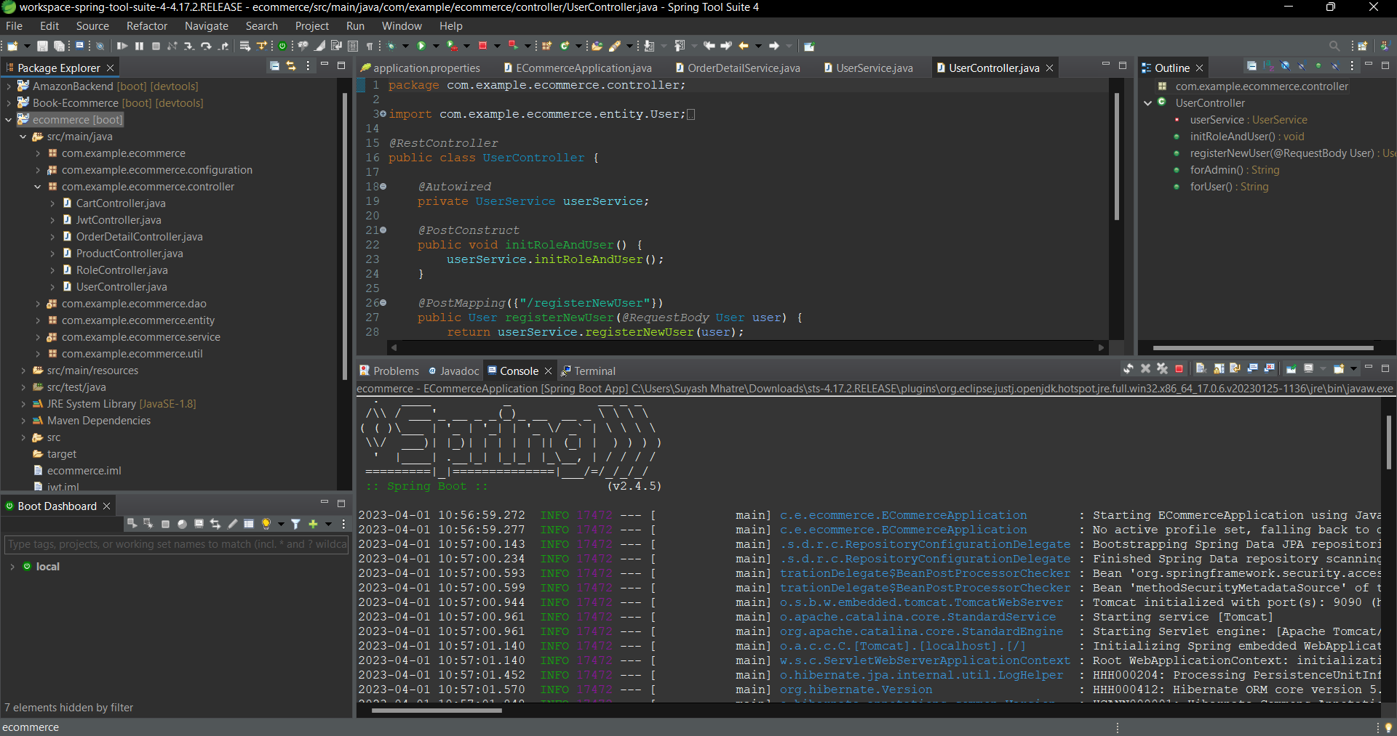
Back-End Snapshot:-

Slide 11
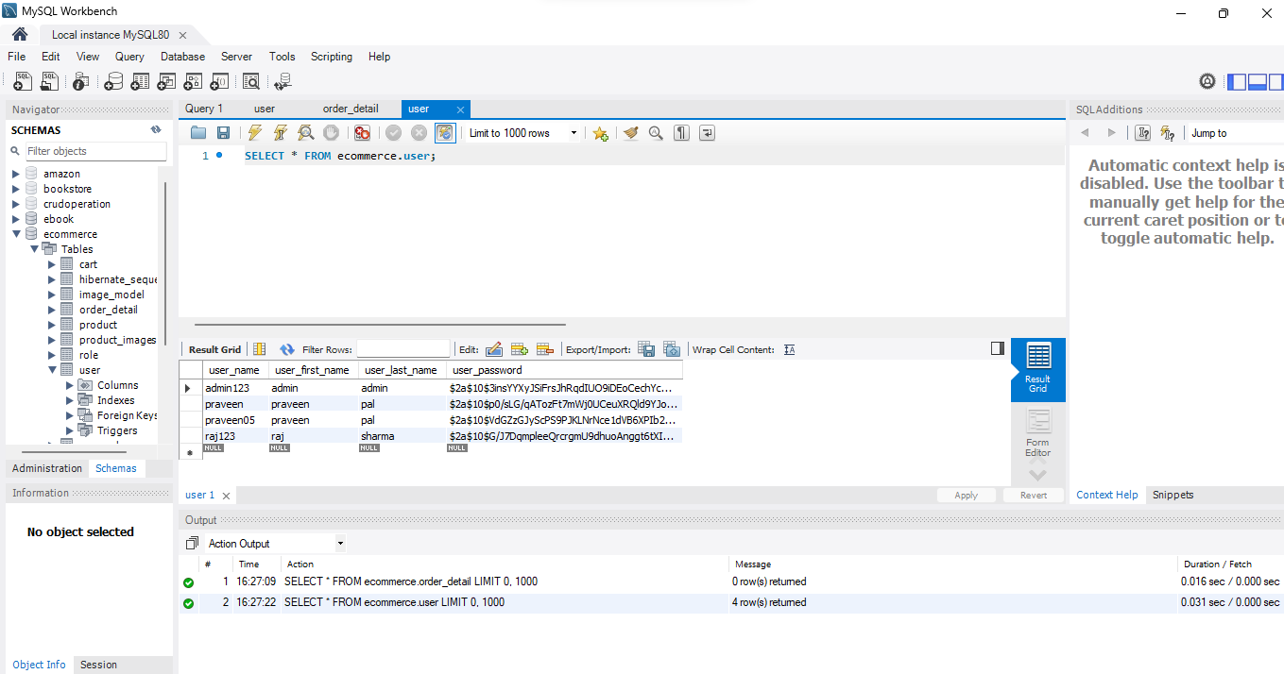
Database-Snapshot

Slide 12
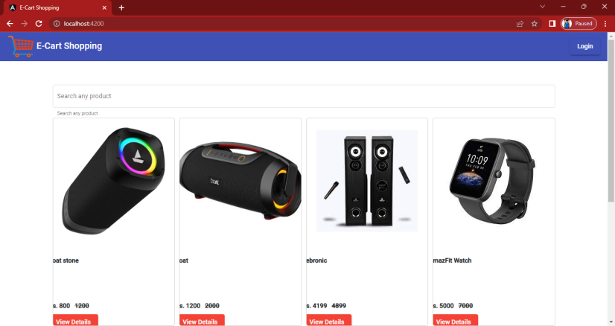
Main Output

Slide 13
Thank You.. .

